Slide 1





24 Hour Hackathon
SUBSECTION ROUND
Team Name: TRIOVITA.
Team Leader's Name:Chirayu .P
Team Members:Ankitha,Deepa, Krithika.
Institution: AJ Institute of Engineering and Technology.

Slide 2

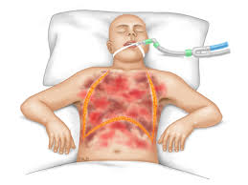
Problem Statement
Develop a non-invasive mmWave radar based system capable of real-time cardiorespiratory monitoring for single individual in same environment. The system should accurately detect, track person’s heart rate and respiration rate

Slide 3
Motivation & Importance
Contact-based monitoring is uncomfortable and limits movement. With rising heart and respiratory diseases and 70% of ICU patients needing continuous tracking, there’s a clear need for a comfortable, contactless, real-time monitoring solution using mmWave radar.

Slide 4
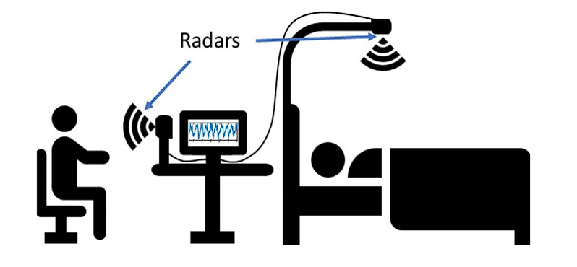
Proposed Solution
Our product is a contactless health monitor that uses radar and an ARM processor to track heart and breathing rates in real time. It works without touch, making it safe and comfortable for patients at home or in hospitals. The system uses smart signal processing and a 3D-printed design to track multiple people accurately and at low cost.
Radar + ARM Based
Fully Contactless
Smart Processing
Affordable & Scalable

Slide 5
Innovation & Uniqueness
Exisitng Solutions | Our Solutions
Contact-based sensors like ECG electrodes, chest straps, and pulse oximeters cause discomfort and restrict movement. | Uses mmWave radar to monitor heart and respiration rates without physical contact, ensuring comfort and freedom.
Limited suitability for long-term or home-based monitoring due to skin irritation, hygiene issues, and wiring. | Enables continuous, non-invasive monitoring suitable for hospitals, elderly care, and smart home environments.
Data often not accessible remotely or lacks integration with mobile systems. | IoT-enabled — data sent to ThingSpeak Cloud and viewed via mobile app for live visualization and alerts.

Slide 6
Implementation Plan
High-Level Roadmap:
Phase 1 – Problem Identification & System Design
Took the problem statement from a medical professional highlighting the need for contactless monitoring.
Designed the system architecture using mmWave radar and ESP32 for real-time heart and breath tracking.
Phase 2 – Development
Implemented radar sensing, signal processing, and IoT connectivity (ThingSpeak Cloud).
Built a working prototype with wireless operation and mobile integration.
Phase 3 – Testing & Deployment
Tested system accuracy for heart and respiration rate detection.
Deployed prototype with mobile app visualization and real-time alerts.

Slide 7
Timeline
Month 1
Research & Setup
Month 2
Data Tuning
Month 3 Visualization
Month 4 UI & Tracking
Month 5 Testing & Docs

Slide 8
Impact & Benefits
Promotes innovation in IoT-based healthcare by integrating mmWave radar and ESP32 for contactless vital tracking.
Offers a low-cost alternative to expensive hospital monitoring systems, reducing healthcare expenses. Enhances remote patient care for elderly and chronically ill individuals, improving comfort and safety. Gain hands-on experience in embedded systems and biomedical technology. Industries and healthcare sectors can adopt this for scalable, smart health solutions.

Slide 9
Team & Conclusion
Team Members:
Ms. Ankita M Naik (4JK22EC005) – Research, Documentation & Presentation
Mr. Chirayu P (4JK22EC012) – System Design & Hardware Integration
Ms. Deepa J Shetty (4JK22EC015) – Data Processing & Signal Analysis
Ms. Krithika (4JK22EC026) – IoT and Cloud Connectivity
Under the Guidance of: Dr. Gnane Swarnadh Satapathi – Associate Professor Department of Electronics and Communication Engineering, AJIET
Why Our Idea Deserves to Win: Because it delivers accurate, contactless, and affordable health monitoring — a step toward smarter, more human-centered healthcare.
Contact: pchirayu871@gmail.com

